Slide 1

Christopher B. Barrett Cornell University AAEA International Section virtual panel on “Navigating International Development Research in a Changing Funding Climate” May 27, 2026
What Now?
What Does A New World Order Mean for International Development Research?

Slide 2
What’s Changed?
Funding
Sharp contraction of ODA (relative to 2-5 yrs ago … still WAY up relative to 1990s-2000s)
Greater restrictions on public research funding
Competition
All major economics/public policy programs now host international development research programs
Rising selectivity of prominent journals raises evidentiary standards for research
Localization
(Overdue) shift towards prioritizing locally-led research
Distrust in science/scientists

Slide 3
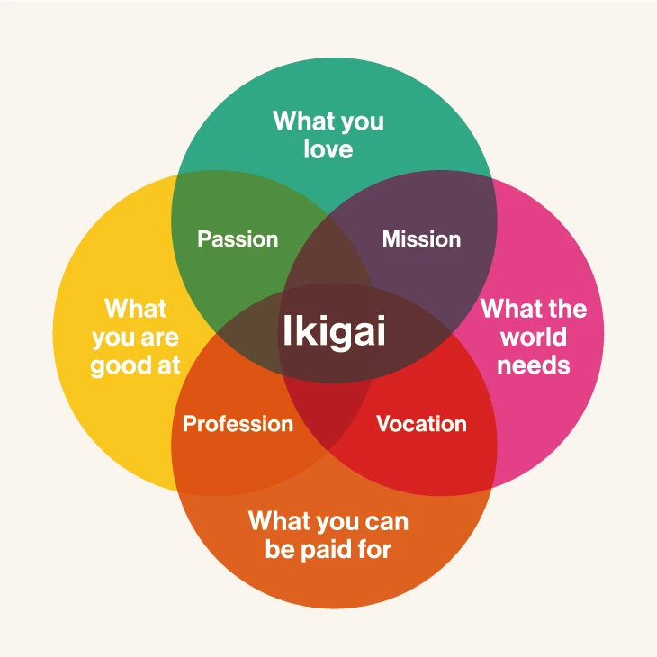
Implications
1. Play to comparative advantage
As a field, ag econ strongly multidisciplinary, deeply empirical, committed to research for impact. That plays.
As individuals, what are your relative strengths? Contextual knowledge? Technical skills? Topical passion?
Build a reputation for your comparative advantage that induces others to invite you to join their team(s).
Image credit: https://www.japan.go.jp/kizuna/2022/03/ikigai_japanese_secret_to_a_joyful_life.html

Slide 4
Implications
2. Portfolio diversification
Within topic/place of comparative advantage, build a portfolio of partners and funders. Cushions against disruptions.
Example, Senegal work:
Small university grants
NSF SBE
NSF Bio
European Foundation
NIH

Slide 5
Implications
3. Relationships
Localization: find the right local partners, build relationships. Be open to serving as tech support, rather than the star.
Operational agencies and administrative data: underused resource.
Program officers: attend events, ask questions. They want grantees who get the vision, want to learn where research is heading, and don’t want to waste your/their time.

Slide 6
Implications
4. Heightened attention to research ethics
Trust is lower and relationships more important. So must focus more on ethical concerns (and political realities).
IRB/IACUC approval - low bar for interventions. Do better.
Reproducibility and replicability

Slide 7
Implications
5. Leverage secondary data
If $ for few experiments is more scarce, focus on what is more plentiful: data. Relative marginal value of another RCT falling.
Alternatives:
Descriptive/predictive work using secondary data, esp. data fusion.
Meta analysis
Comparative methods assessments
Good journals publish these when done carefully, on important questions, using high quality data.

Slide 8
Adapt
Change has come fast.
It’s ok to grieve and gripe.
But adapt. The world needs you and your talents more than ever. Find and double down on your ikigai.

